Slide 1
Why Study Compilers? (1)
Compiler techniques are everywhere
Parsing (little languages, interpreters)
Parsing, scanning, static analysis
Database engines
AI: domain-specific languages
Text processing
Tex/LaTex -> dvi -> Postscript -> pdf
Hardware: VHDL; model-checking tools
Mathematics (Mathematica, Matlab)

Slide 2
Why Study Compilers? (3)
Ideas from many parts of CSE
AI: Greedy algorithms, heuristic search
Algorithms: graph algorithms, dynamic programming, approximation algorithms
Theory: Grammars DFAs and PDAs, pattern matching, fixed-point algorithms
Systems: Allocation & naming, synchronization, locality
Architecture: pipelines & hierarchy management, instruction set use
Notes:
Au02: taken from one of Cooper’s slides

Slide 3
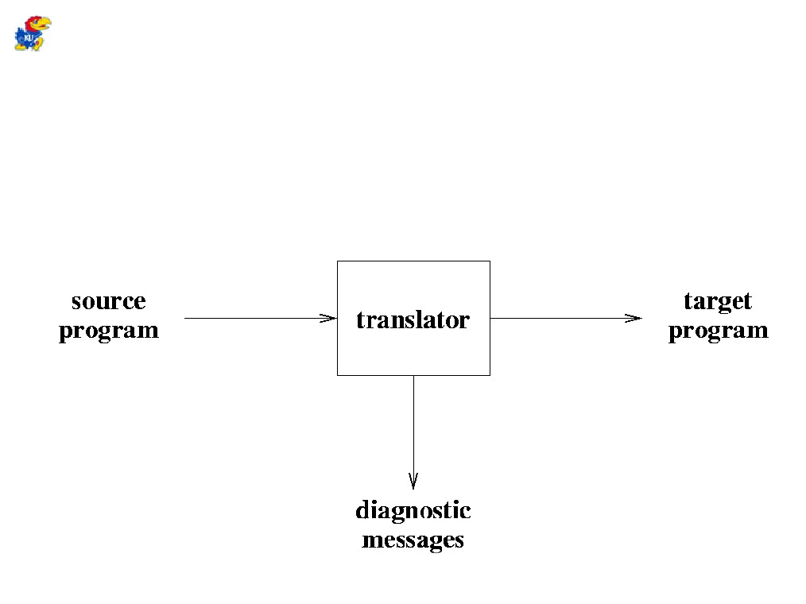
Compiler / Translator
● A translator is a program that reads a program
written in a source language and translates it to an equivalent program written in a target language.
2

Slide 4
Compilers: The Big picture
Source code
Compiler
Assembly code
Assembler
Object code
(machine code)
Linker
Fully-resolved object
code (machine code)
Loader
Executable image

Slide 5
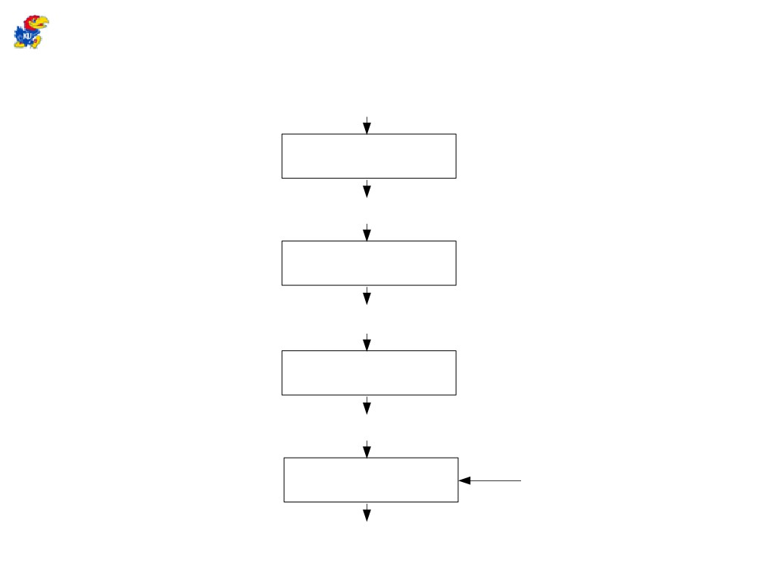
Language Processing System
skeletal source program
pre-processor
source program
compiler
Our Interest
https://www.youtube.com/watch?v=Qkwj65l_96I
target assembly program
assembler
relocatable machine code
loader/link-editor
library,
relocatable object files
absolute machine code
6

Slide 6

Preprocessors
● Perform some preliminary processing on
a source module.
- definitions and macros
● #define
- file inclusion
● #include
- conditional compilation
● #ifdef
- line numbering
● #line
22

Slide 7
Assemblers
● Typically accomplished in 2 passes.
Pass 1: Stores all of the identifiers representing
Tokens in a table.
Pass 2: Translates the instructions and data into
bits for the machine code.
● Produces relocatable code.
23

Slide 8
Linkers and Loaders
● Linker
- Produces an executable file.
- Resolves external references.
- Includes appropriate libraries. ● Loader
- Creates a process from the executable.
Loads the process (or a portion of it) into
Main memory.
- Produces absolute machine code.
24

Slide 9
Applications Related to Compilers
● Compiler Relatives
- Interpreters
- Structure Editors
- Pretty Printers
- Static Checkers
- Debuggers
● Other Applications
- Text Formatters
- Silicon Compilers
- Query Interpreters
7

Slide 10
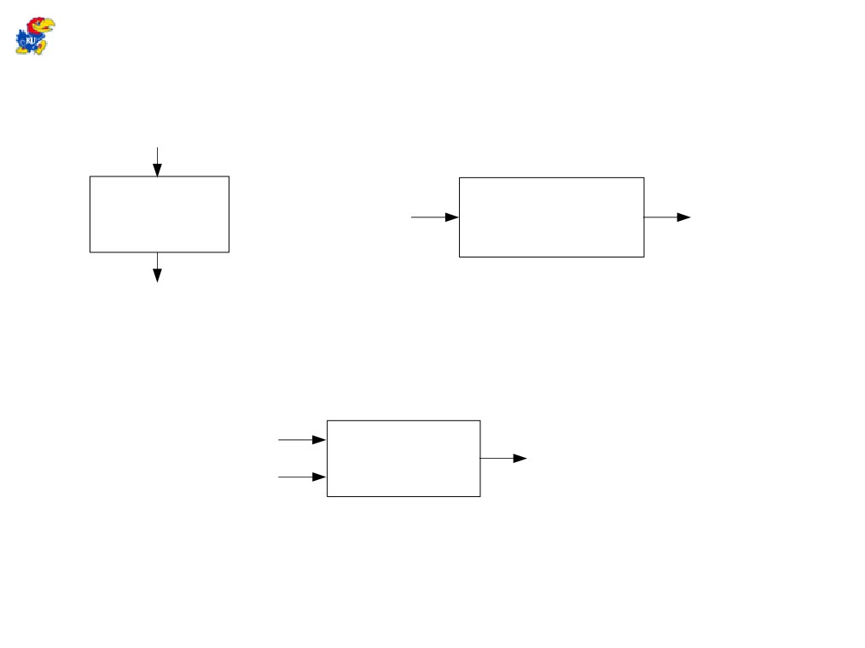
Compiler Vs. Interpreter
source program
Compiler
input
Target Program
output
target program
1. Execution of a compiled program
source program
Interpreter
output
input
2. Execution of an interpreted program
8

Slide 11
Interpreters & Compilers
Interpreter
A program that reads a source program and produces the results of executing that program
Compiler
A program that translates a program from one language (the source) to another (the target)

Slide 12
Common Issues
Compilers and interpreters both must read the input – a stream of characters – and “understand” it; analysis
w h i l e ( k < l e n g t h ) {
<nl>
<tab> i f ( a [ k ] > 0 )
<nl> <tab> <tab>{ n P o s + + ; }
<nl> <tab>
}

Slide 13
Interpreter
Interpreter
Execution engine
Program execution interleaved with analysis
running = true;
while (running) {
analyze next statement;
execute that statement;
}
May involve repeated analysis of some statements (loops, functions)

Slide 14
Compiler
Read and analyze entire program
Translate to semantically equivalent program in another language
Presumably easier to execute or more efficient
Should “improve” the program in some fashion
Offline process
Tradeoff: compile time overhead (preprocessing step) vs execution performance

Slide 15
Typical Implementations
Compilers
FORTRAN, C, C++, Java, COBOL, etc. etc.
Strong need for optimization, etc.
Interpreters
PERL, Python, awk, sed, sh, csh, postscript printer, Java VM
Effective if interpreter overhead is low relative to execution cost of language statements

Slide 16
Hybrid approaches
Well-known example: Java
Compile Java source to byte codes – Java Virtual Machine language (.class files)
Execution
Interpret byte codes directly, or
Compile some or all byte codes to native code
(particularly for execution hot spots)
Just-In-Time compiler (JIT)
Variation: VS.NET
Compilers generate MSIL
All IL compiled to native code before execution

Slide 17
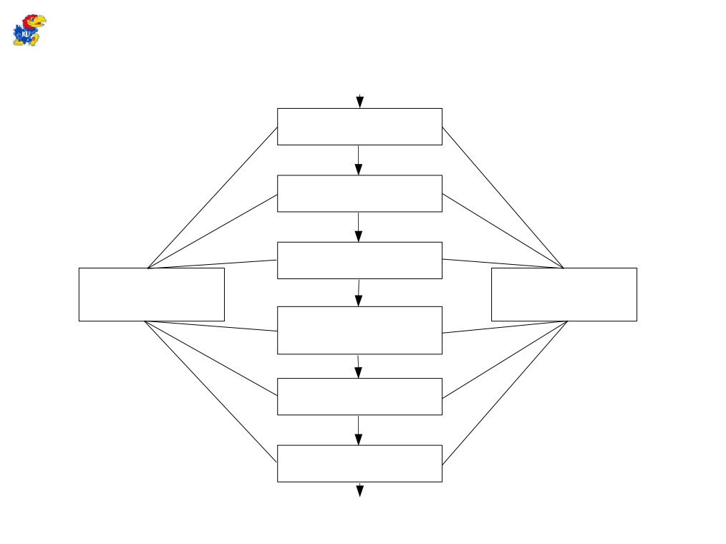
Phases of a Compiler
source program
lexical analyzer
syntax analyzer
semantic analyzer
symbol-table manager
error
https://www.youtube.com/watch?v=Qkwj65l_96I
handler
intermediate code generator
code optimizer
code generator
target program
10

Slide 18
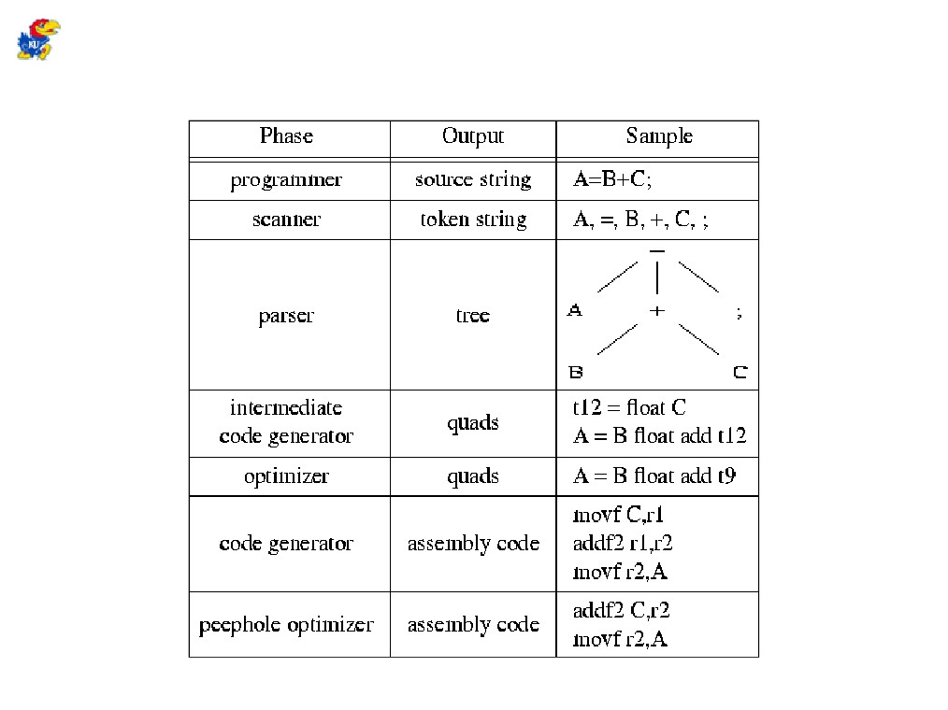
Compiler Phases
9

Slide 19
Intermediate Code Generation
● After analysis, most compilers generate an intermediate representation of a program.
● Properties
- machine-independent
- easy to translate to the target machine language
● Can have a common intermediate language that is the target of several front ends and is input to several back ends.
18

Slide 20
Code Optimization
● Often performed on intermediate code.
● Goals
- Make program run faster.
- Make program take up less space.
- Make program use less power.
● Should never change the semantic behavior
of the program.
19

Slide 21
Code Generation
● Produces assembly or object code from the intermediate representation.
● Each intermediate operation is translated to an equivalent sequence of machine instructions.
● Special features of the architecture are
exploited.
20

Slide 22
Compiler Construction Tools
● Front End (Analysis)
- Scanner Generators: Lex
- Parser Generators: Yacc
- Syntax-Directed Translation Engines ● Back End (Synthesis)
- Automatic Code Generators
- Peephole Optimizer Construction Tools
11

Slide 23
Structure of a Compiler
First approximation
Front end: analysis
Read source program and understand its structure and meaning
Back end: synthesis
Generate equivalent target language program
Source
Front End
Back End
Target

Slide 24
Implications
Must recognize legal programs (& complain about illegal ones)
Must generate correct code
Must manage storage of all variables
Must agree with OS & linker on target format
Source
Front End
Back End
Target
Notes:
Au02: from Cooper’s slides

Slide 25
More Implications
Need some sort of Intermediate Representation (IR)
Front end maps source into IR
Back end maps IR to target machine code
Source
Front End
Back End
Target
Notes:
Au02: from Cooper’s slides

Slide 26
Front End
Scanner
Parser
source
tokens
IR
Split into two parts
Scanner: Responsible for converting character stream to token stream
Also strips out white space, comments
Parser: Reads token stream; generates IR
Both of these can be generated automatically
Source language specified by a formal grammar
Tools read the grammar and generate scanner & parser (either table-driven or hard coded)
Notes:
Lex, yacc examples

Slide 27
Back End
Responsibilities
Translate IR into target machine code
Should produce fast, compact code
Should use machine resources effectively
Registers
Instructions
Memory hierarchy

Slide 28
Back End Structure
Typically split into two major parts with sub phases
“Optimization” – code improvements
May well translate parser IR into another IR
Code generation
Instruction selection & scheduling
Register allocation

Slide 29
Example (Output assembly code)
Unoptimized Code
Optimized Code
s4addq $16,0,$0
mull $16,$0,$0
addq $16,1,$16
mull $0,$16,$0
mull $0,$16,$0
ret $31,($26),1
lda $30,-32($30)
stq $26,0($30)
stq $15,8($30)
bis $30,$30,$15
bis $16,$16,$1
stl $1,16($15)
lds $f1,16($15)
sts $f1,24($15)
ldl $5,24($15)
bis $5,$5,$2
s4addq $2,0,$3
ldl $4,16($15)
mull $4,$3,$2
ldl $3,16($15)
addq $3,1,$4
mull $2,$4,$2
ldl $3,16($15)
addq $3,1,$4
mull $2,$4,$2
stl $2,20($15)
ldl $0,20($15)
br $31,$33
$33:
bis $15,$15,$30
ldq $26,0($30)
ldq $15,8($30)
addq $30,32,$30
ret $31,($26),1

Slide 30
Standard Compiler Structure
Source code
(character stream)
Lexical analysis
Token stream
Front end
(machine-independent)
Parsing
Abstract syntax tree
Intermediate Code Generation
Intermediate code
Optimization
Intermediate code
Back end
(machine-dependent)
Code generation
Assembly code

Slide 31
Tokens
Token stream: Each significant lexical chunk of the program is represented by a token
Operators & Punctuation: {}[]!+-=*;: …
Keywords: if while return goto
Identifiers: id & actual name
Constants: kind & value; int, floating-point character, string, …

Slide 32
Scanner Example
Input text
// this statement does very little
if (x >= y) y = 42;
Token Stream
Note: tokens are atomic items, not character strings
IF
LPAREN
ID(x)
GEQ
ID(y)
RPAREN
ID(y)
BECOMES
INT(42)
SCOLON

Slide 33
Parsing
Parsing: reconstruct the derivation (syntactic structure) of a program
In principle, a single recognizer could work directly from the concrete, character-by-character grammar
In practice this is never done

Slide 34
Parser Output (IR)
Many different forms
(Engineering tradeoffs)
Common output from a parser is an abstract syntax tree
Essential meaning of the program without the syntactic noise
Notes:
Au02: plan on drawing something here

Slide 35
Parser Example
Token Stream Input
Abstract Syntax Tree
IF
LPAREN
ID(x)
ifStmt
GEQ
ID(y)
RPAREN
>=
assign
ID(y)
BECOMES
INT(42)
SCOLON
ID(x)
ID(y)
ID(y)
INT(42)

Slide 36
Example derivation
program
program ::= statement | program statement
statement ::= assignStmt | ifStmt
assignStmt ::= id = expr ;
ifStmt ::= if ( expr ) stmt
expr ::= id | int | expr + expr
id ::= a | b | c | i | j | k | n | x | y | z
int ::= 0 | 1 | 2 | 3 | 4 | 5 | 6 | 7 | 8 | 9
program
stmt
stmt
ifStmt
a = 1 ;
if ( a + 1 )
b = 2 ;
assign
expr
stmt
ID(a)
expr
expr
expr
assign
int (1)
ID(a)
int (1)
ID(b)
expr
int (2)

Slide 37
Analysis-Synthesis Model of Compilation
● Analysis Part
- Breaks up the source program into pieces and creates an intermediate representation.
● Synthesis Part
- Constructs a target program from the intermediate representation.
13

Slide 38
3 Phases of Analysis in a Compiler
● Linear Analysis
- Read a stream of characters and group into tokens. ● Hierarchical Analysis
- Group tokens into hierarchical structures. ● Semantic Analysis
- Perform certain checks to ensure that the program components fit together correctly.
14

Slide 39
Linear Analysis
● In a compiler this is also called
lexical analysis or scanning.
position := initial+rate*60;
=>
position, :=, initial, +, rate, *, 60, ;
15

Slide 40
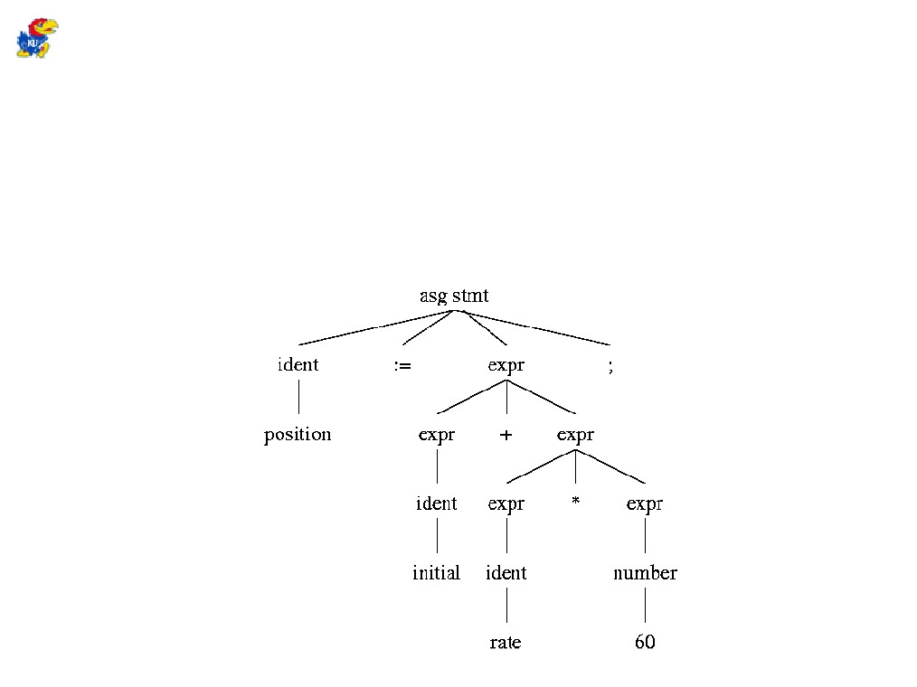
Hierarchical Analysis
● In a compiler this is called parsing or
syntax analysis.
● It is usually expressed in a set of recursive rules
called a grammar.
● Can be represented in a parse tree.
16

Slide 41
Semantic Analysis
● Checks for errors that can't be checked though syntax analysis alone.
- Consistent use of types Type checking type compatibility
.
- Variables declared before referenced.
● Determines where conversions need to be performed.
17

Slide 42
Compilation in a Nutshell 1
Source code
(character stream)
if (b == 0) a = b;
Lexical analysis
Token stream
if
(
b
==
0
)
a
=
b
;
Parsing
if
==
=
;
Abstract syntax tree
(AST)
b
0
a
b
if
Semantic Analysis
boolean
int
Decorated AST
==
=
;
int b
int 0
int a
lvalue
int b

Slide 43
Compilation in a Nutshell 2
if
boolean
int
==
=
;
int b
int 0
int a
lvalue
int b
Intermediate Code Generation
CJUMP ==
MEM
CONST
MOVE
NOP
Optimization
+
0
MEM
MEM
fp
8
+
+
fp
4
fp
8
CJUMP ==
Code generation
CX
CONST
MOVE
NOP
CMP CX, 0
CMOVZ DX,CX
0
DX
CX

Slide 44
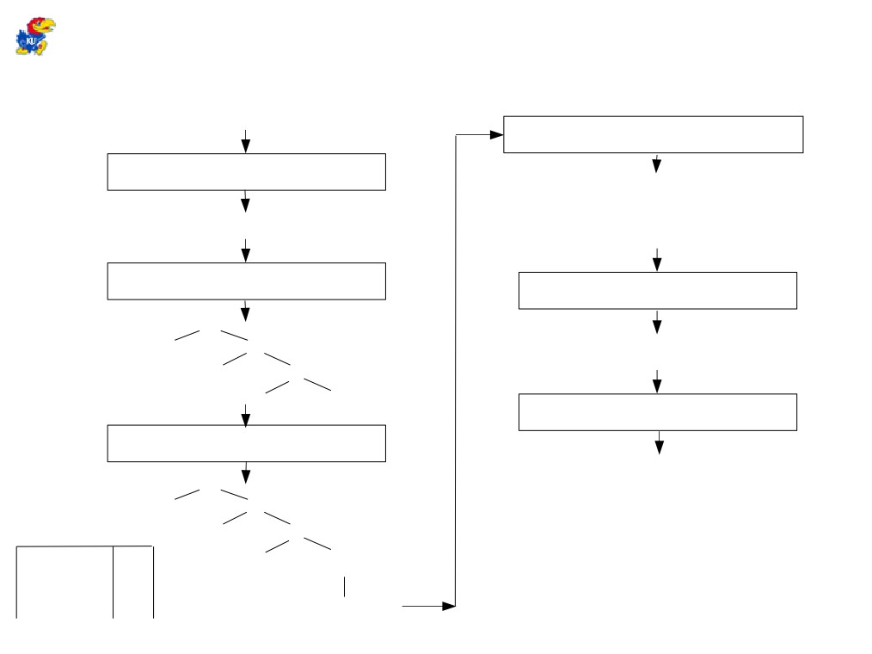
Translation of a Statement
position = initial + rate * 60
intermediate code generator
lexical analyzer
temp1 = inttoreal(60) temp2 = id3 * temp1 temp3 = id2 + temp2 id1 = temp3
id1 = id2 + id * 60
3
syntax analyzer
code optimizer
=
temp1 = id3 * 60.0 id1 = id2 + temp1
id +
1
id
2
id 60
3
code generator
semantic analyzer
MOVF id3, R2 MULF #60.0, R2
=
id +
MOVF id2, R1
1
ADDF R2, R1
symbol table id *
position
2
MOVF R1, id1
id3
inttoreal
initial
rate
60

